Slide 1
Stakeholder analysis on Pokémon Battle Performance Model
Jacky

Slide 2
Problems
Can I guess/predict the outcome of a Pokémon battle?
But rather than problems, there are more opportunities:
Looking for patterns in Pokémons (eg creating new Pokémons)
AI plays Pokémon battles
AI builds teams of Pokémon

Slide 3
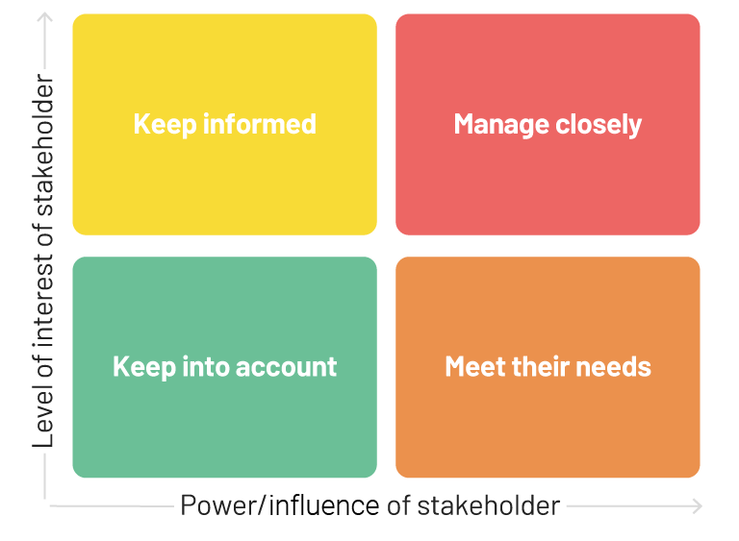
Stakeholders (real life)
Pokémon streamers (e.g. The Official Pokémon YouTube channel)
May use the model as a tool, to create more content to talk about
Pokémon gamers/Pokémon Video Game Championships (VGC) participants
Focus on team building and strategy
They create data
Website: https://pokemonshowdown.com/
Organiser of a Pokémon battle platform
They are the rules
Pokémon game developers
create the game and Pokémons
They are the creators
organisers
gamers
streamers
game developers

Slide 4
Stakeholders (world of Pokémon)
Ash
Main character
Basically all Pokémon trainers
just like VGC participants in real life
Gyms, Pokémon League, Elite Four, Champion
Organiser of Pokémon battles
With the characteristics of Pokémon trainers
Pokémon Researchers
Not sure
Pokémon villain teams (bad guys)
Not sure how they affect or could be affected
But any technology offered to them is bad
Gyms, Pokémon League, Elite Four, Champion
pokémon trainers
villain teams
researchers

Slide 5
Measure the performance
For gamers and VGC participants (trainers and villains):
They care if this will bring them victory (how much they can win rather than lose)
Most likely Accuracy and Precision (PPV), as there is no punishment on losing a battle, but depending on their battling style
For organisers:
Everything, as they make the rules
For game developers:
Similar to organisers
But may want to know which Pokémons are popular/strong/weak
So that they can boost/buff/nerf them, balance the game
For Pokémon researchers:
Tell them Everything

Slide 6
Costs of mis-identifying
In my opinion:
Cost of False Negative > Cost of False positive
False Negative -> reduces the diversity of the strategies
False positive -> may lead to more analysis about that battle
no penalty on losing a battle
Positive = win
Negative = Lose

